Slide 1
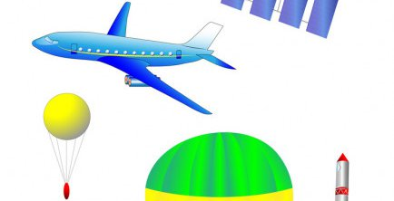
TAKE ME HIGH APP
Powered by: Space 4 All. “Democraitizing access to Space”

Slide 2
TAKE ME HIGH APP
Space seems a very far and difficult activity for common people
We are proposing to develop an App which could guide the user (from middle schoolers to elder people) across all the process to make a succesfull launching of their own low cost HAB, and reach the near space (20 km at least).
This App, will have numerous tabs with lessons, each one addressing subjects as planning, preparation, launch, tracking, and recovery . Including mission planning, generating a bill of materials, links to tracking and weather resources.
We want to help get Access to Space for All

Slide 3
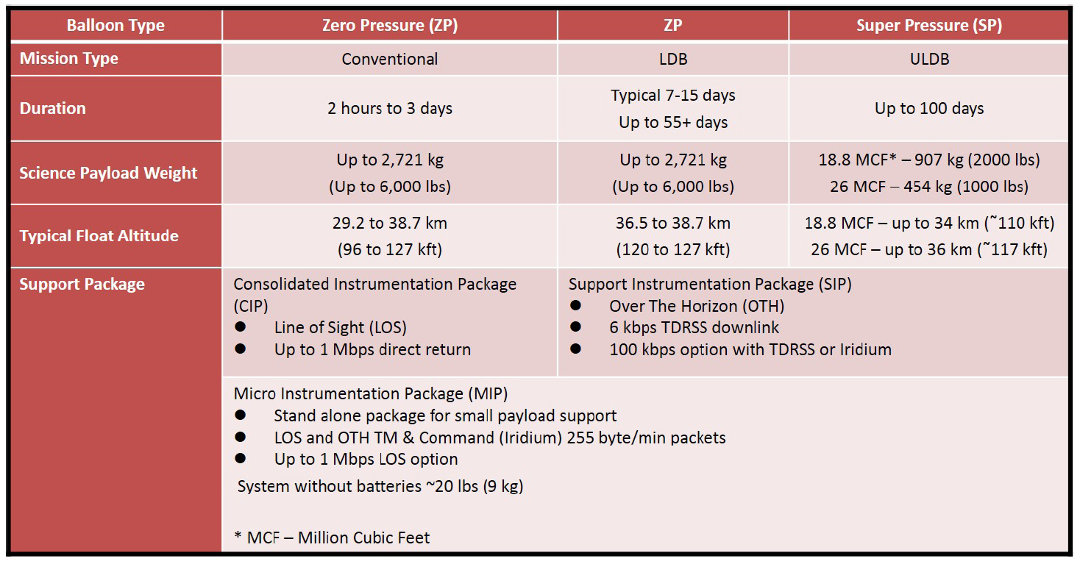
Balloon Operational Data
NASA's Balloon Operational Support Capability chart.

Slide 4
Launching a HAB Mission
Steps:
Planning
Buying
Building
Contact local authorities (mainly aviation ATC and city hall)
Launching
Tracking
Recovery

Slide 5
Low Cost HAB BOM
ITEM
Latex 98 “ Balloon and rope
Parachute
Helium
Payload (Photo Camera)
Pocket Tracker for Android (GPS)
Reflector made from aluminium foil and cardboard.

Slide 6
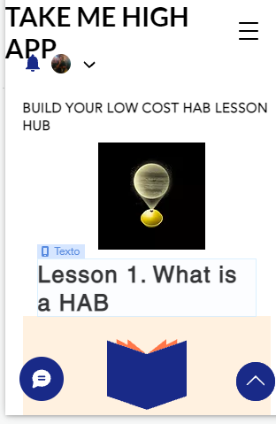
Build Your Own HAB
With our App we will take you step by step from zero.

Slide 7
Build Your Own HAB
Based on your calculations (weight of payload and height to fly), buy an inflate with helium your balloon.
Tie the rope previously to the balloon
Then tie the parachute
From the parachute tie the reflector you have made by covering a cardboard piece with aluminium foil
Then tie the payload (a foam cooler with a little hole and a camera on it), as well as a little weight extra.

